Slide 1



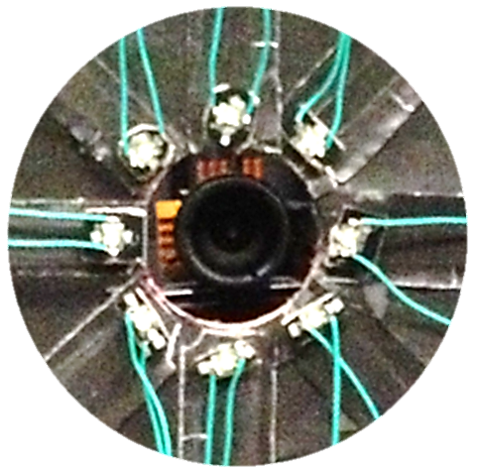
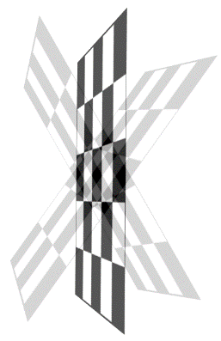
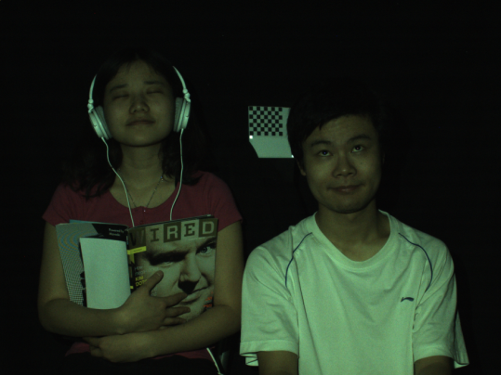
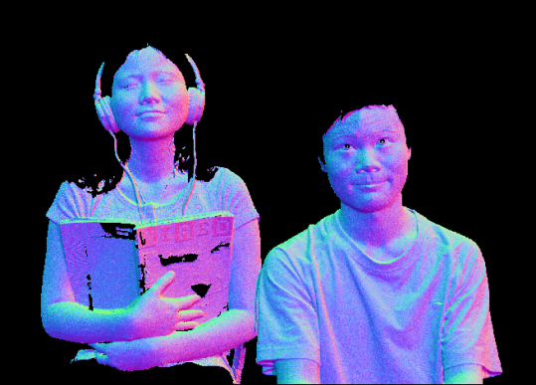

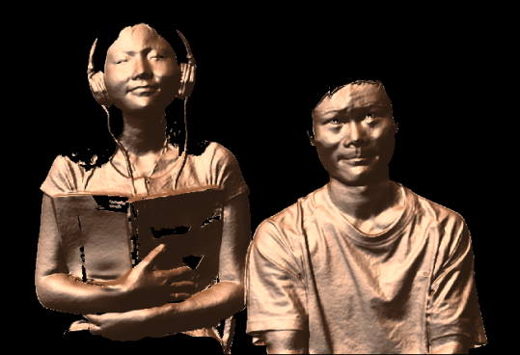
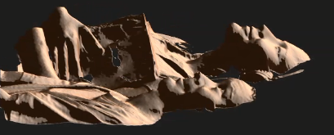
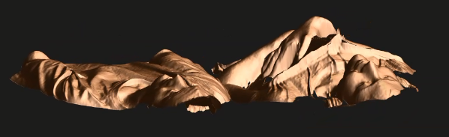
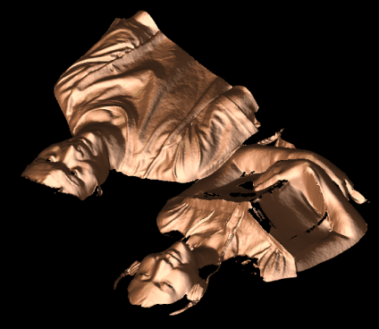





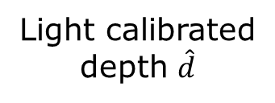




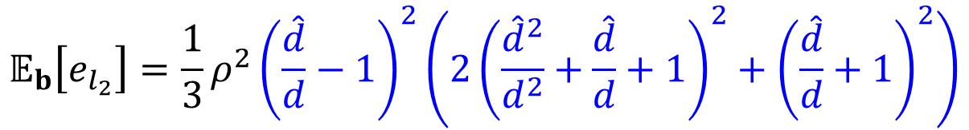
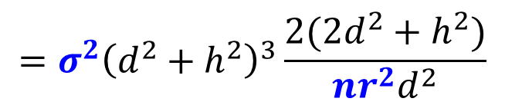



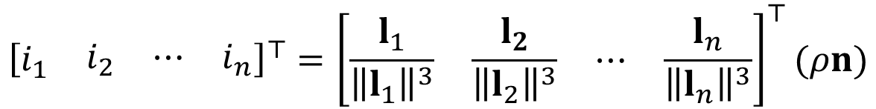




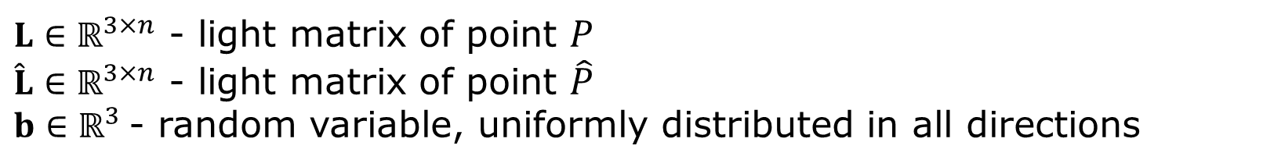






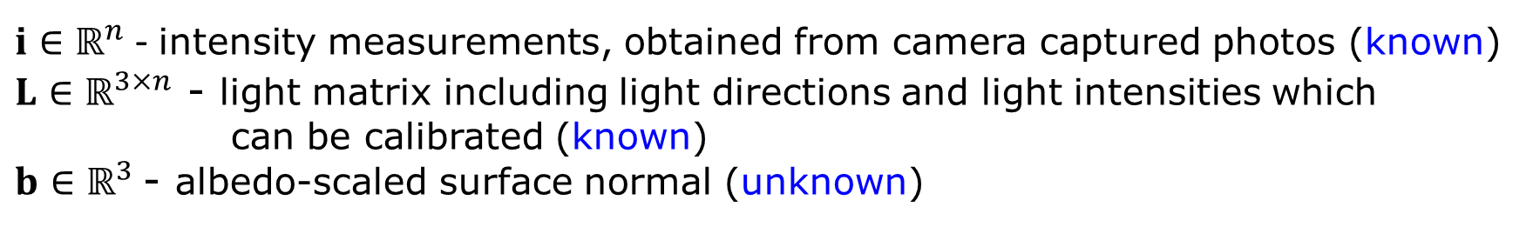
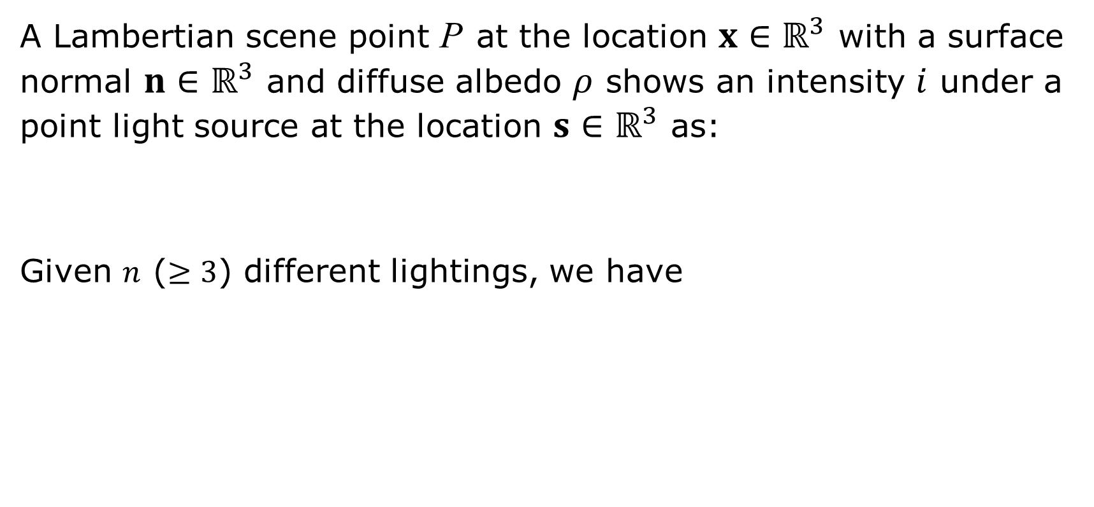






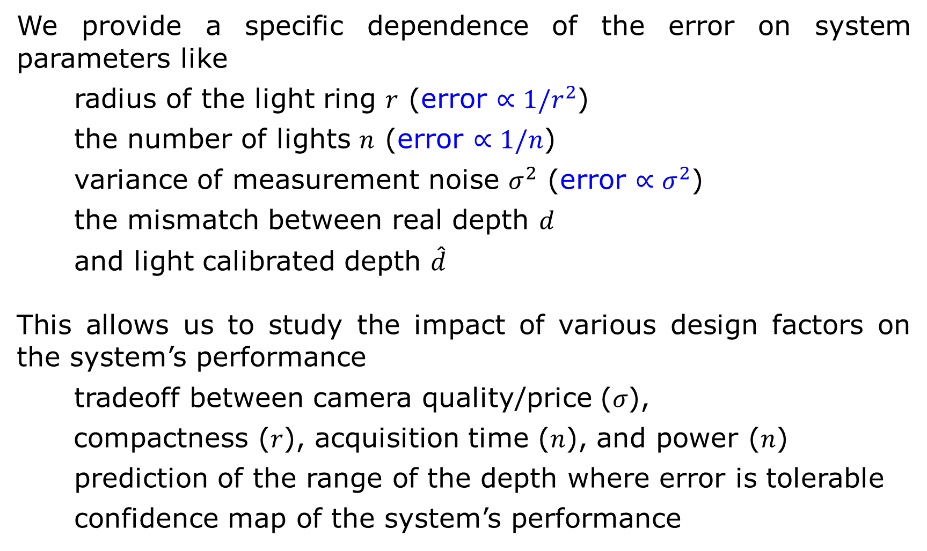




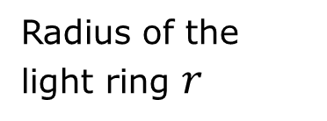
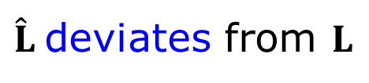






Photometric Stereo with Small Angular Variations
Jian Wang¹, Yasuyuki Matsuhita², Boxin Shi³, Aswin C. Sankaranarayanan¹
¹Carnegie Mellon Univ., ²Osaka Univ., ³Singapore Univ. of Technology and Design
Proposed Device
Analysis of the Device
Experiments
We propose a compact photometric stereo system with a light ring of radius $r$ and a camera placed at the center of the ring seeking to sense a scene whose depth$d$is significantly larger than $r$, and
characterize the system’s performance.
In reality
$$\hat{b}={\left(\hat{L}{\hat{L}}^{⊤}\right)}^{−1}\hat{L}\hat{i}$$
$$\hat{i}=i+Δi_{g}$$
(due to measurement noise)
LED
Checkerboard
is rotated.
$\hat{L}$ deviates from $L$
(due to depth mismatch)
$$n_{3}$$
$$n_{4}$$
$P$
then $\hat{b}$ differs from the ground truth $b$
Camera
$$l$$
Scene point
height $h$
In the presence of measurement noise
$$n_{2}$$
$$n_{1}$$
Radius of the light ring $r$
Estimation of $b$:
$$\hat{b}={\left(LL^{⊤}\right)}^{−1}L\hat{i}={\left(LL^{⊤}\right)}^{−1}L\left(i+Δi_{g}\right)$$
Light calibration method
$n$ lights
Scene depth $d$
$$=b+{\left(LL^{⊤}\right)}^{−1}LΔi_{g}$$
40 mm
We obtain the light vector from a light to
a location by varying the orientation of a
planar checkerboard and imaging it under
the light’s illumination.
Contributions
$Δi_{g}∈ℝ^{n}$ - noise term, random variable (noise is i.i.d. with mean 0 and variance $σ^{2}$)
Hardware prototype
We provide a specific dependence of the error on system parameters like
radius of the light ring $r$ (error $∝{1/r}^{2}$)
the number of lights $n$ (error $∝1/n$)
variance of measurement noise $σ^{2}$ (error $∝σ^{2}$)
the mismatch between real depth $d$
and light calibrated depth $\hat{d}$
This allows us to study the impact of various design factors on the system’s performance
tradeoff between camera quality/price (𝜎),
compactness (𝑟), acquisition time (𝑛), and power (𝑛)
prediction of the range of the depth where error is tolerable
confidence map of the system’s performance
Error evaluation:
$$e_{l_{2}}={\left\|\hat{b}−b\right\|}^{2}$$
$$=σ^{2}{\left(d^{2}+h^{2}\right)}^{3}\frac{2(2d^{2}+h^{2})}{nr^{2}d^{2}}$$
$$∙$$
Error expectation:
$$𝔼_{Δi_{g}}\left[e_{l_{2}}\right]$$
$$∙$$
$$∙$$
In the presence of calibration error
$$∙$$
Camera assumes scene point at depth $d$ is at light calibrated depth $\hat{d}$.
$$P$$
$P$
(a) One of the input
(b) Surface normal map
$$∙$$
$$∙$$
$$d$$
$$∙$$
$$d$$
Sensing model
Estimation of $b$:
$$\hat{b}={\left(\hat{L}{\hat{L}}^{⊤}\right)}^{−1}\hat{L}i={\left(\hat{L}{\hat{L}}^{⊤}\right)}^{−1}\hat{L}L^{⊤}b$$
A Lambertian scene point P at the location $x∈ℝ^{3}$ with a surface normal $n∈ℝ^{3}$ and diffuse albedo $ρ$ shows an intensity $i$ under a point light source at the location $s∈ℝ^{3}$ as:
Given $n$ ($≥3$) different lightings, we have
$L∈ℝ^{3×n}$ - light matrix of point $P$
$\hat{L}∈ℝ^{3×n}$ - light matrix of point $\hat{P}$
$b∈ℝ^{3}$ - random variable, uniformly distributed in all directions
$$i=\frac{l^{⊤}}{{\left\|l\right\|}^{3}} ρn$$
, where
$$l=s−x$$
Error expectation:
$$𝔼_{b}\left[e_{l_{2}}\right]=\frac{1}{3}ρ^{2}{\left(\frac{\hat{d}}{d}−1\right)}^{2}\left(2{\left(\frac{{\hat{d}}^{2}}{d^{2}}+\frac{\hat{d}}{d}+1\right)}^{2}+{\left(\frac{\hat{d}}{d}+1\right)}^{2}\right)$$
$${\left[\begin{matrix}i_{1} & \begin{matrix}i_{2} & ⋯ & i_{n}\end{matrix}\end{matrix}\right]}^{⊤}={\left[\begin{matrix}\frac{l_{1}}{{\left\|l_{1}\right\|}^{3}} & \frac{l_{2}}{{\left\|l_{2}\right\|}^{3}} & \begin{matrix}⋯ & \frac{l_{n}}{{\left\|l_{n}\right\|}^{3}}\end{matrix}\end{matrix}\right]}^{⊤}(ρn)$$
$$𝔼_{b}\left[e_{l_{2}}\right]$$
$$i$$
The decrease in accuracy is gradual on
each side of the light calibrated depth,
so there exists a range where error is
tolerable.
$$L^{⊤}$$
$$b$$
(c) Integrated surface
$i∈ℝ^{n}$ - intensity measurements, obtained from camera captured photos (known)
$L∈ℝ^{3×n}$ - light matrix including light directions and light intensities which
can be calibrated (known)
$b∈ℝ^{3}$ - albedo-scaled surface normal (unknown)
Results of human scene (1m X 0.7m)
Light calibrated
depth $\hat{d}$
Real depth $d$
Reference
$$⇒$$
$b$ can be computed as $b={\left(LL^{⊤}\right)}^{−1}Li$
When we have both errors, the expected error is simply linear combination of the two.
Ondrej Drbohlav and Mike Chantler, "On optimal light configurations in photometric stereo." ICCV 2005

